Slide 1









Sport Products Sales Data Analysis
Presenters
Ahmed Osama
Hassan Reda
Mohamed El Dardiri
Mustafa Maher
Mohab Mohamed
Mohamed Mostafa

Slide 2

Agenda
Introduction and Project Objectives
Dataset Overview and Data Analysis Process
Visualizations and Dashboards

Slide 3


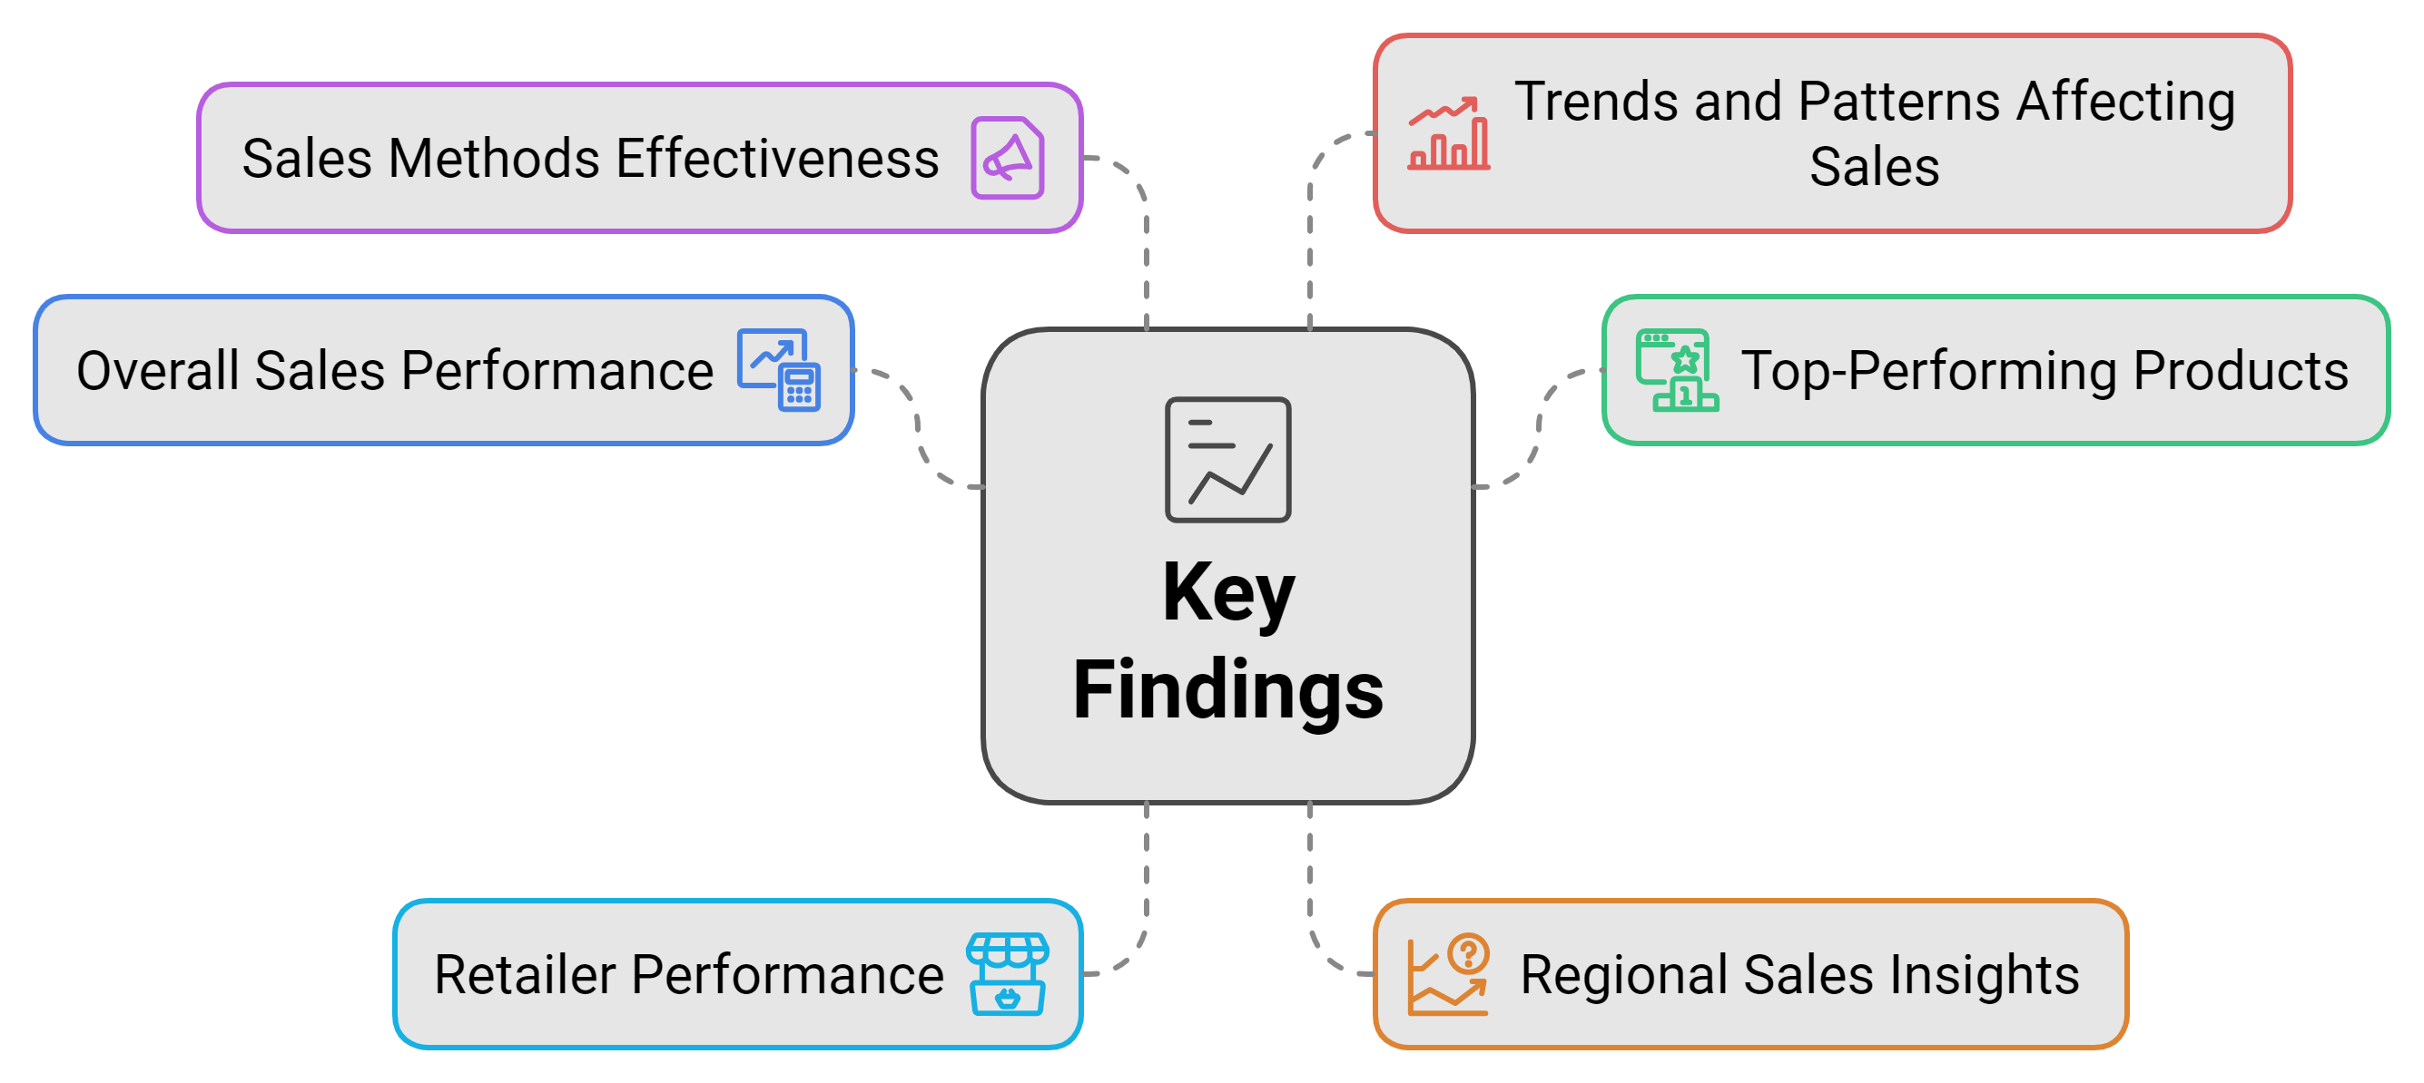
Introduction
Purpose
Comprehensive Sales Data Analysis by utilize Microsoft Power BI to thoroughly analyze our sales data and aim to transform raw data into meaningful insights.

Slide 4

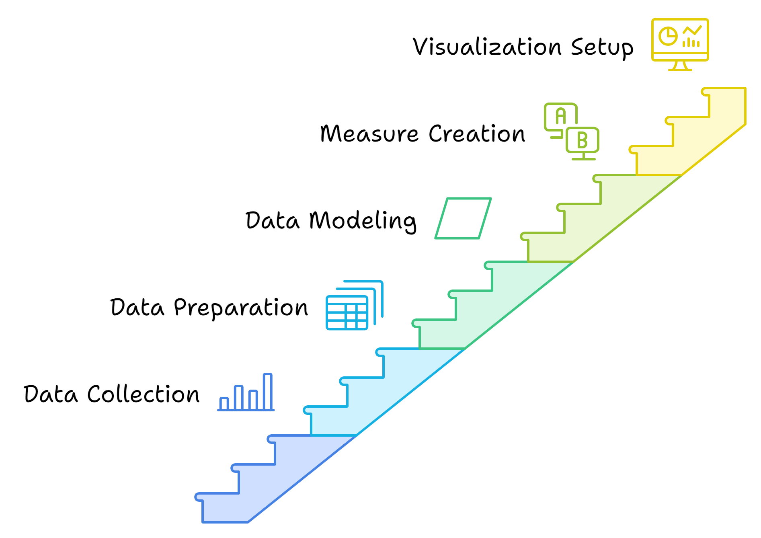
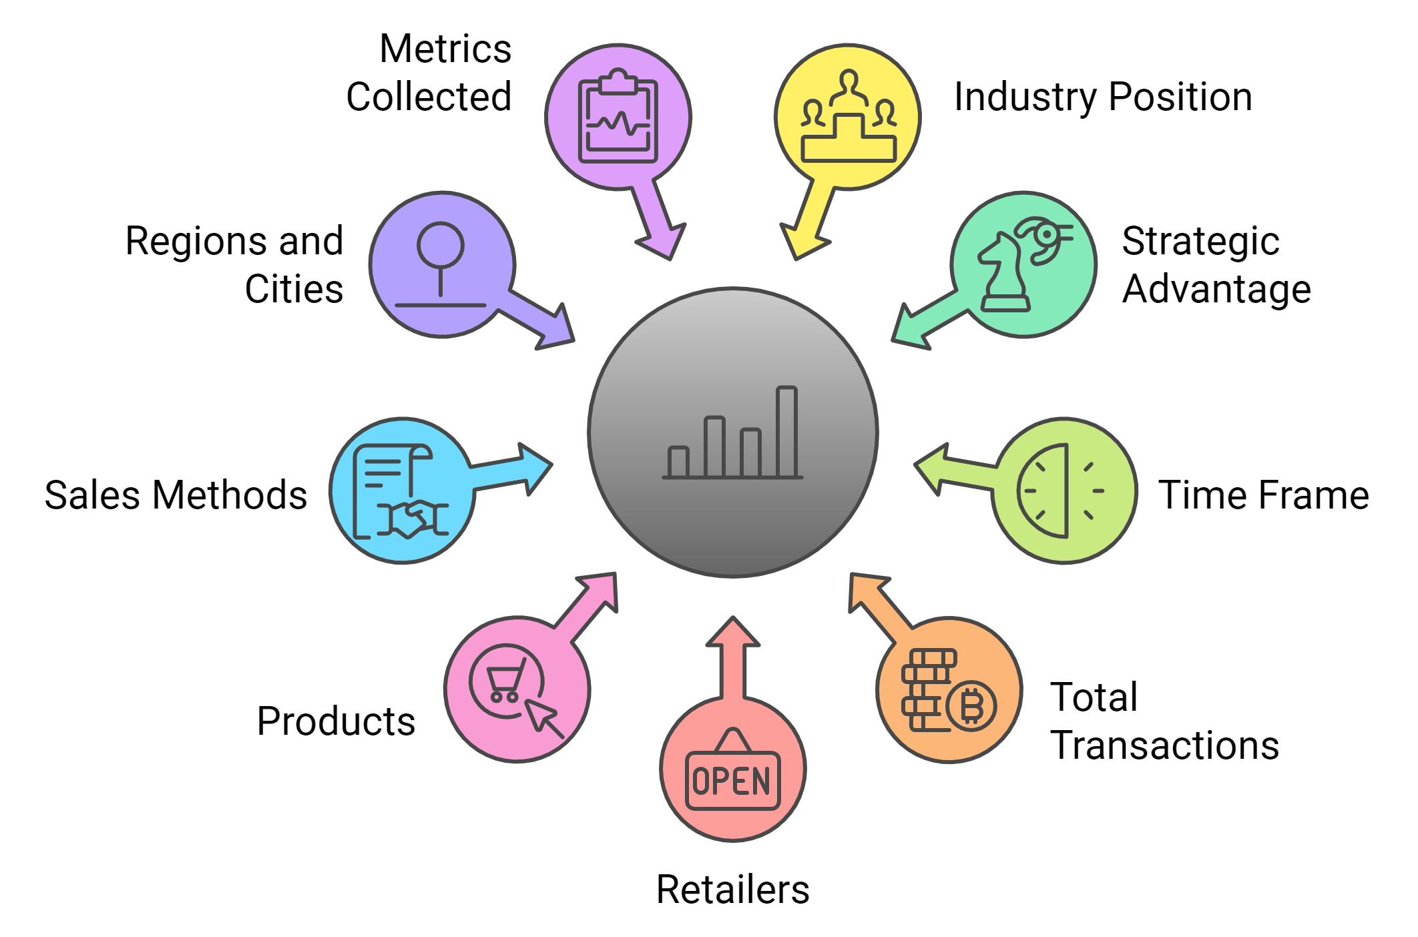
Dataset Overview
Dataset Description
Data Analysis Process

Slide 5
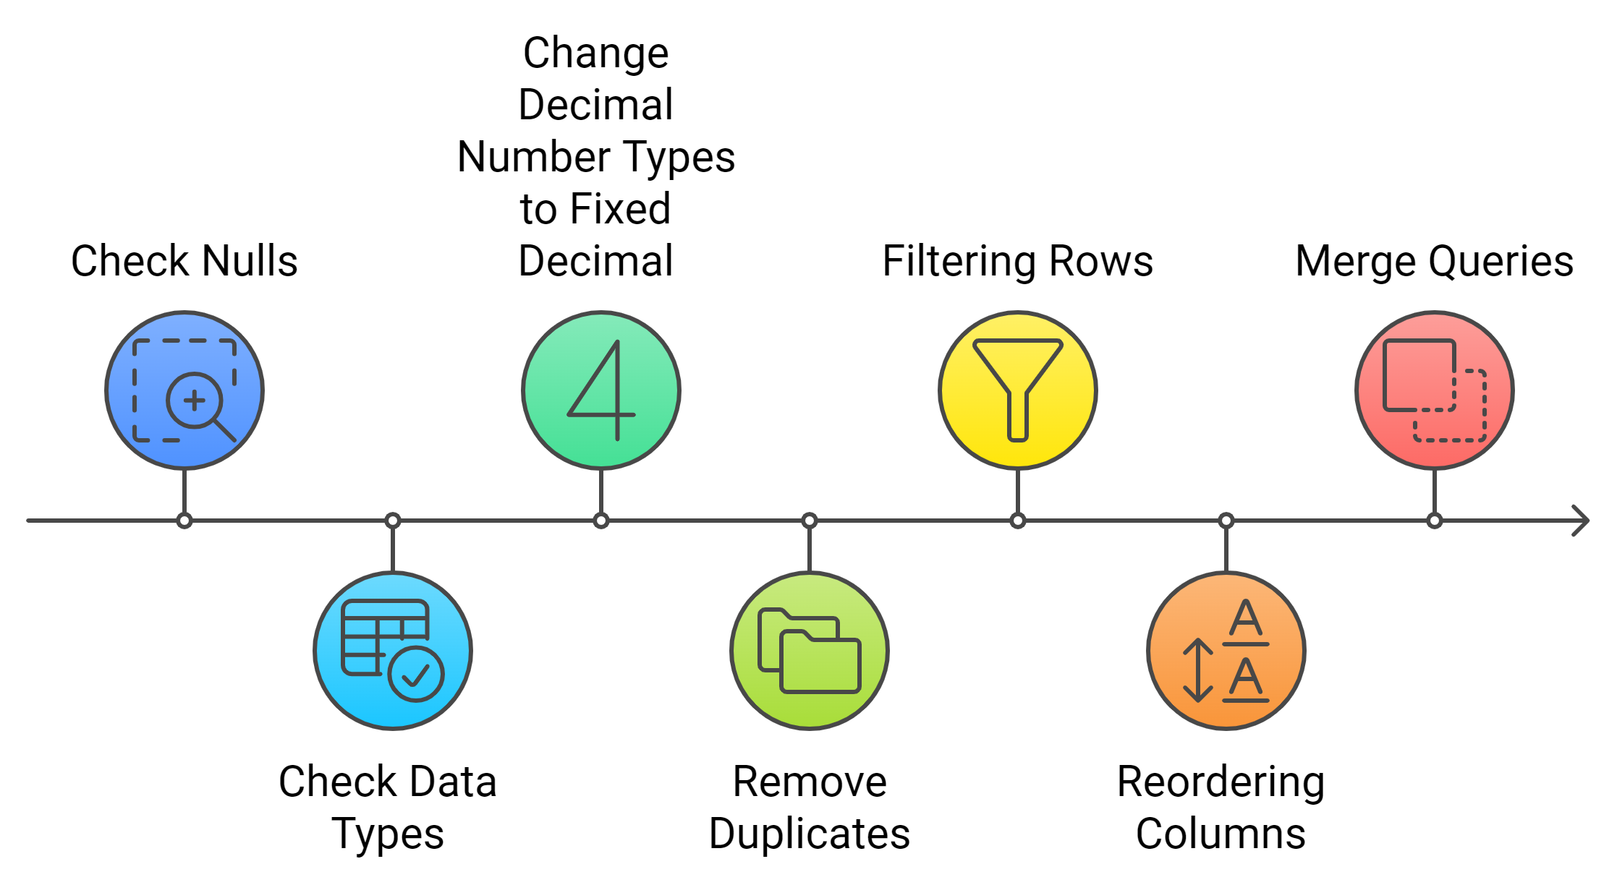
Data Transforming

Slide 6
Product Sales Performance Overview
“
”

Slide 7
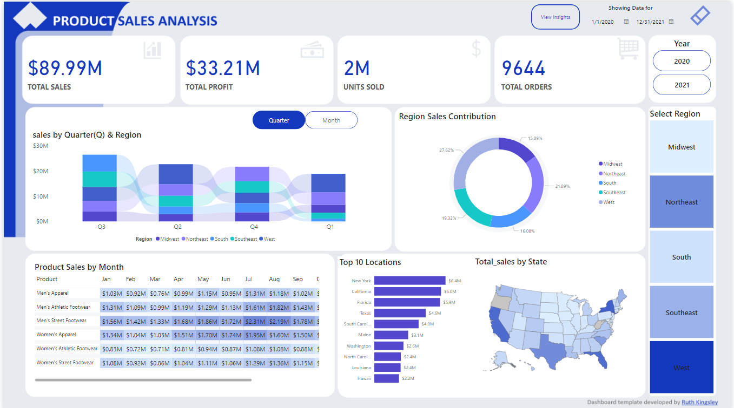

Slide 8
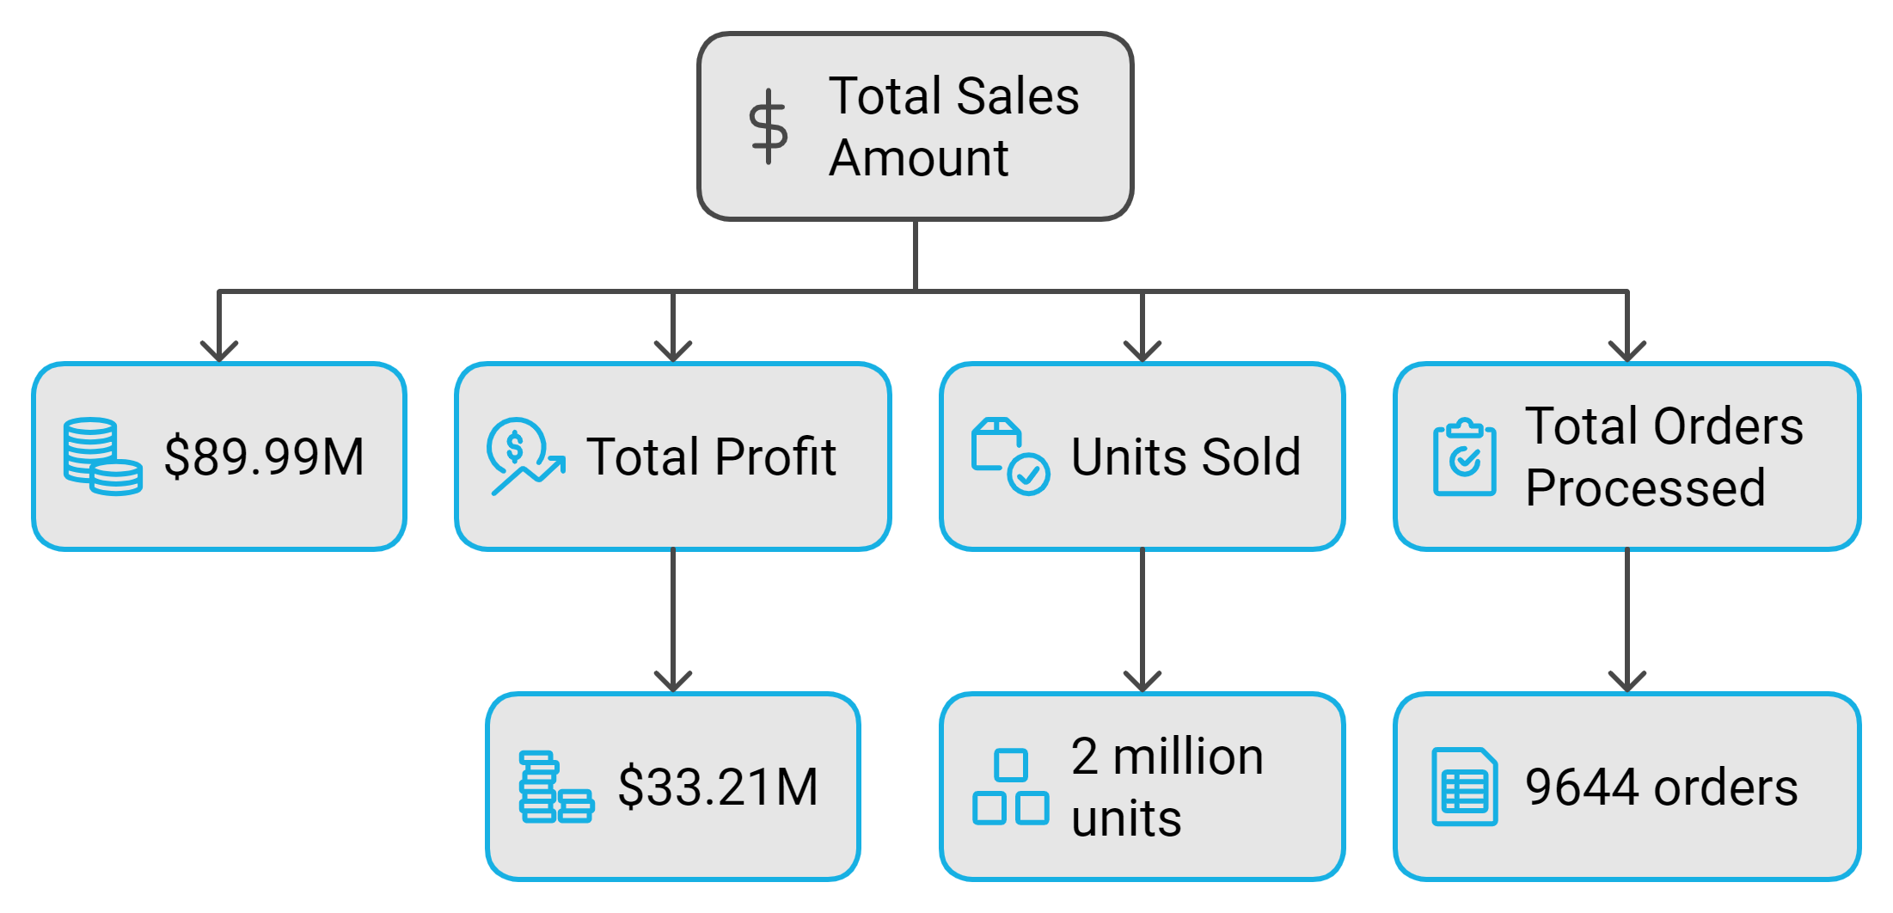
What are the total sales, profit, units sold, and total orders processed during the selected time period?

Slide 9
Product Sales & Performance
“
”

Slide 10
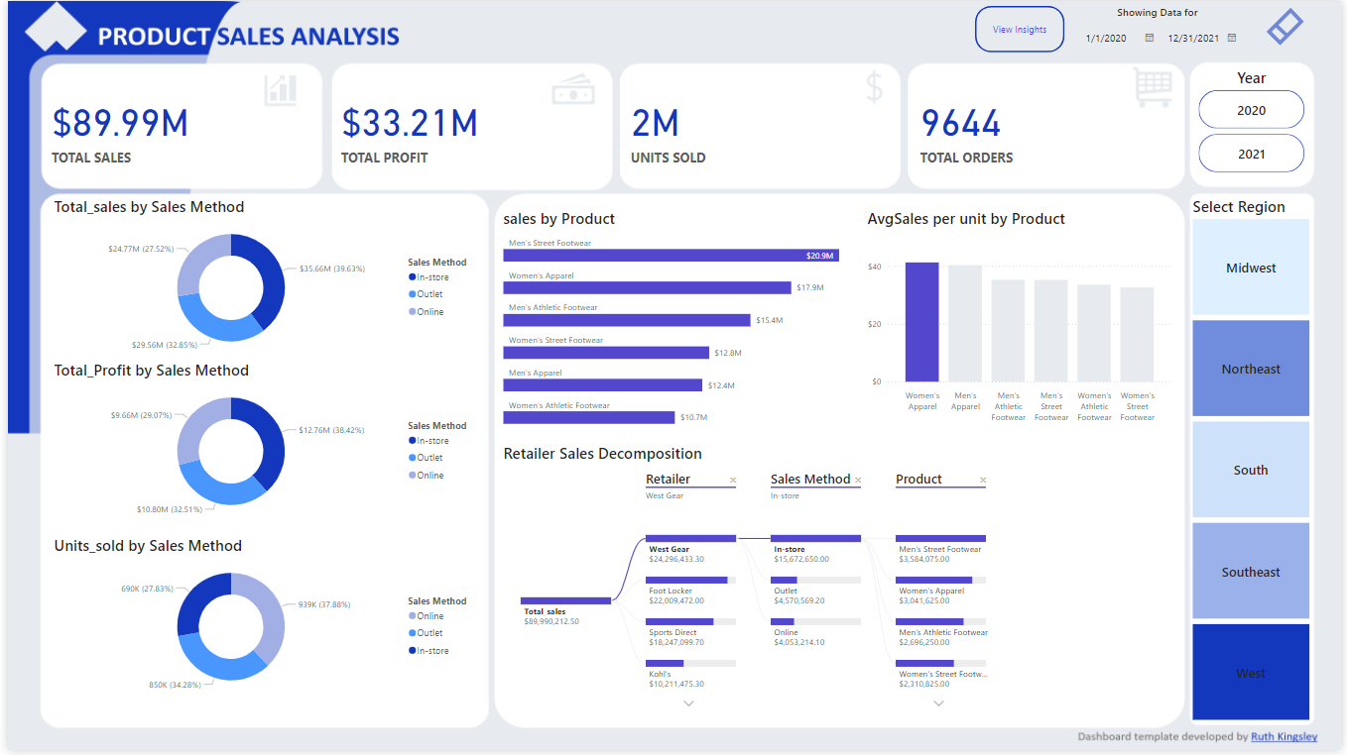

Slide 11
Findings Analysis
“
”

Slide 12
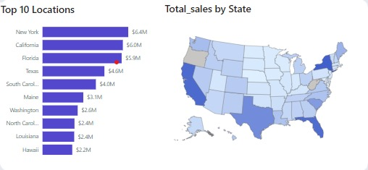
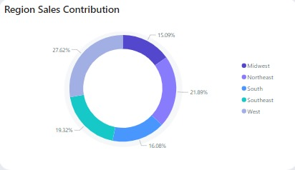
The chart provides a visual representation of the top 10 states in terms of total sales.
Top-selling states:
New York is the clear leader with total sales of $6.4 million.
California and Florida follow closely behind with sales of $6.0 million and $5.9 million, respectively.
Texas, South Carolina, Maine, Washington, North Carolina, Louisiana, and Hawaii round out the top 10 with sales ranging from $4.6 million to $2.2 million.
Sales distribution:
The sales are concentrated in the eastern and western regions of the United States.
The central and southern regions have lower overall sales compared to the east and west.
Geographic patterns:
New York and California have the highest sales, which may be attributed to their large populations and economic activity.
Florida's high sales could be due to its tourism industry and large retiree population.
Texas's sales may be driven by its energy sector and large population.

Slide 13
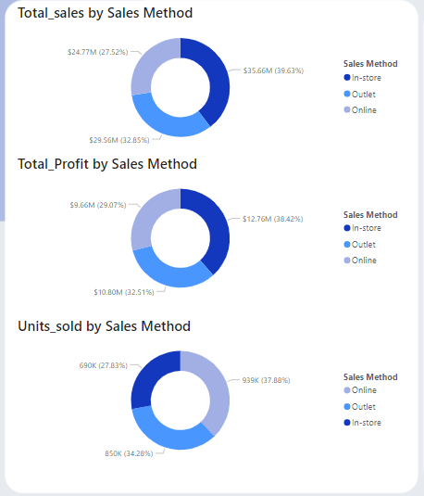
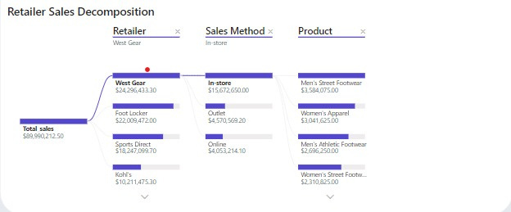
Retailer Performance:
West Gear is the top-performing retailer with total sales of $24,296,433.30.
Foot Locker and Sports Direct follow with sales of $22,009,472.00 and $18,247,099.70, respectively.
Kohl's has the lowest sales at $10,211,475.30.
Sales Method Performance:
In-store is the dominant sales method, contributing to the sales of West Gear.
Outlet is used by Foot Locker and contributes to their sales.
Online is the sales method for Sports Direct.
Product Category Performance:
Men's Street Footwear is the top-selling product category, contributing to the sales of West Gear.
Women's Apparel and Women's Street Footwear also have significant sales.
Men's Athletic Footwear has the lowest sales among the analyzed products.
Sales Performance: Outlet is the top sales method (39.63%), followed by Online (32.85%) and In-store (27.52%). Outlet and Online channels drive the majority of sales.
Profit Distribution: Outlet leads in profit contribution (38.42%), with Online at 32.51% and In-store at 29.07%. While Outlet is most profitable, In-store's profit percentage is close.
Units Sold : Outlet also leads in units sold (37.88%), with Online and In-store both contributing 27.83%. Outlet sells more units per transaction, driving both sales and profit.

Slide 14
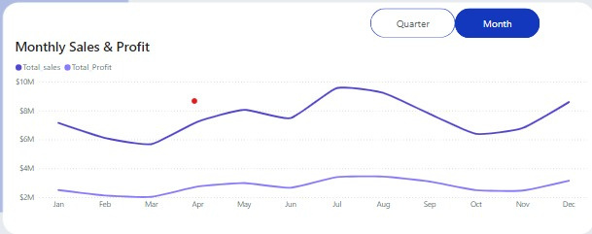
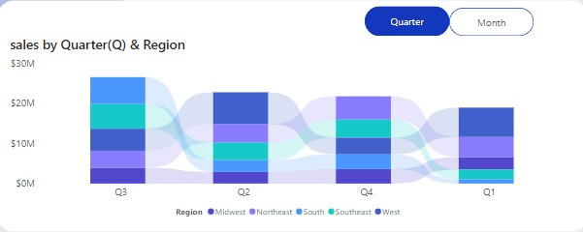
The chart indicates a strong correlation between sales and profit.
The business experienced significant growth from April to July.
The slight decline in sales and profit from August to October may be due to seasonal factors or other external influences.
The rebound in sales and profit in November and December suggests that the business is recovering from any temporary setbacks.
Regional sales:
The Midwest region has the highest sales in all quarters.
The Northeast region has the second-highest sales in all quarters.
The South, Southeast, and West regions have relatively similar sales levels across all quarters.
Quarter-over-quarter trends:
Sales in the Midwest region increased from Q1 to Q3 and then declined in Q4.
Sales in the Northeast region increased from Q1 to Q2 and then remained relatively stable in Q3 and Q4.
Sales in the South, Southeast, and West regions fluctuated throughout the year, with no clear trends.

Slide 15
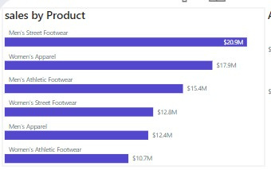
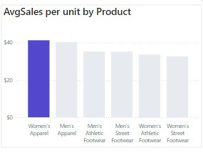
Sales distribution:
The average sales per unit for the other product categories are relatively similar, ranging from $30 to $35.
Men's Apparel and Men's Athletic Footwear have slightly higher average sales per unit than Men's Street Footwear and Women's Athletic Footwear.
Product performance:
Women's Apparel stands out as the product category with the highest average sales per unit, indicating that it is priced higher or has a higher perceived value Although, Men's and Women's Street Footwear have the highest sales, indicating strong demand for these categories .
The other product categories have relatively similar average sales per unit, suggesting that pricing and value perception may be comparable.

Slide 16

Thank you

